Slide 1
Announcements
Midterm 2 scores are out.
Regrade requests will open on April 4th, at noon.
Regrade requests will close on April 9th, at noon.
If you’re interested in 1-on-1 meetings with course staff to discuss life, see https://piazza.com/class/j9j0udrxjjp758?cid=3258

Slide 2
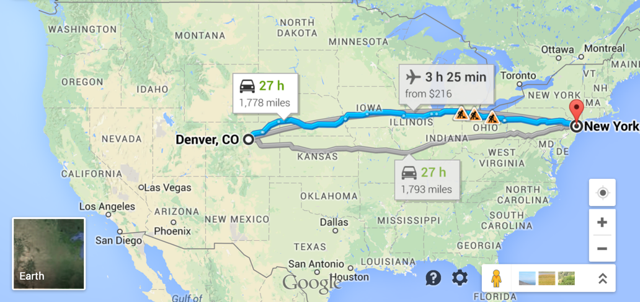
CS61B
Lecture 29: DFS vs. BFS, Shortest Paths
Summary So Far
Dijkstra’s Algorithm
A*
Extra: A* Properties, Iterative DFS

Slide 3
Reachability: Review of Last Week
Suppose you wanted to collect a list of all vertices reachable from a given start vertex. We’ve discussed two approaches so far to perform this task:
Depth First Search.
Breadth First Search.
Questions:
Do both work for all graphs?
Is one better than the other in some way?
8
3
0
1
4
6
s
5
7
2
8

Slide 4
Reachability: Review of Last Week
Questions:
Do both work for all graphs?
Is one better than the other in some way?
BFS gives you a 2-for-1 deal, also get shortest paths as a bonus.
DFS vs. BFS:
They both work in the absence of physical constraints on computers.
Performance depends on situation.
When would DFS be worse, i.e. use lots more memory than BFS?
Deep call stack -- spindly graph.
When would BFS be worse?
Graph is super bushy. Like absurdly so. Imagine 1,000,000 vertices that are all connected. 999,999 will be enqueued at once.

Slide 5
Graph Problems (So Far)
Problem | Problem Description | Solution | Efficiency
s-t paths | Find a path from s to every reachable vertex. | DepthFirstPaths.java Demo, Iterative Demo | Θ(V+E) time Θ(V) space
topological sort | Find an ordering of vertices consistent with directed edges. | DepthFirstOrder.java Demo | Θ(V+E) time Θ(V) space
shortest s-t paths | Find the shortest path from s to evey reachable vertex. | BreadthFirstPaths.java Demo | Θ(V+E) time Θ(V) space
Punchline:
DFS and BFS both traverse entire graphs, just in a different order (like preorder, inorder, postorder, and level order for trees).
Solving graph problems is often a question of identifying the right traversal. Many traversals may work.
Example: DFS for topological sort. BFS for shortest paths.
Example: DFS or BFS about equally good for checking existence of path.

Slide 6
BreadthFirstSearch for Google Maps
From two lectures ago: Would breadth first search be a good algorithm for a navigation tool (e.g. Google Maps)?
Assume vertices are intersection and edges are roads connecting intersections.

Slide 7
BreadthFirstSearch for Google Maps
From two lectures ago: Would breadth first search be a good algorithm for a navigation tool (e.g. Google Maps)?
Assume vertices are intersection and edges are roads connecting intersections.
No! Shortest path is not the one involving the fewest number of intersections.
Important missing detail: Length of roads (i.e. distance between intersections).

Slide 8
Dijkstra’s Algorithm

Slide 9
Problem: Single Source Single Target Shortest Paths
Goal: Find the shortest paths from source vertex s to some target vertex t.
Observation: Solution will always be a path with no cycles (assuming non-negative weights).
3
v distTo[] edgeTo[]
0 0.0 -
1 2.0 0→1
2 - -
3 - -
4 5.0 1→4
5 9.0 4→5
6 - -
11
1
1
2
2
3
6
5
4
5
s
0
1
1
4
1
2
15
Shortest path from s=0 to t=5
5

Slide 10
Problem: Single Source Shortest Paths
Goal: Find the shortest paths from source vertex s to every other vertex.
3
v distTo[] edgeTo[]
0 0.0 -
1 2.0 0→1
2 1.0 0→1
3 11.0 6→3
4 5.0 1→4
5 9.0 4→5
6 10.0 4→6
11
1
1
2
2
3
6
5
4
5
s
0
1
1
4
1
2
15
Shortest paths from s=0
5
Trickier observation: Solution will always be a tree.
Can think of as the union of the shortest paths to all vertices.

Slide 11
Problem: Single Source Shortest Paths
Why is the solution a tree?
Can’t include cycles (no reason to go in a loop).
Every node has one parent.
If a graph has no cycles and no node has two parents, it’s a tree.
...
...
4
4
2
15
Why are we sure that every node has only one parent?
5
...

Slide 12
Problem: Single Source Shortest Paths
Why is the solution a tree?
Can’t include cycles (no reason to go in a loop).
Every node has one parent.
If a graph has no cycles and no node has two parents, it’s a tree.
...
...
4
4
2
15
Why are we sure that no every node has only one parent?
If one path is longer, it shouldn’t be part of the solution.
If they’re the same, it’s ok to pick one arbitrarily.
5
...

Slide 13
SPT Edge Count: http://yellkey.com/half
If G is a connected edge-weighted graph with V vertices and E edges, how many edges are in the Shortest Paths Tree (SPT) of G? [assume every vertex is reachable]
3
1
6
s
4
0
2
5

Slide 14
SPT Edge Count
If G is a connected edge-weighted graph with V vertices and E edges, how many edges are in the Shortest Paths Tree of G? [assume every vertex is reachable]
V: 7
Number of edges in SPT is 6
Always V-1:
For each vertex, there is exactly one input edge (except source).
3
1
6
s
4
0
2
5

Slide 15
SPT Edge Count
If G is a connected edge-weighted graph with V vertices and E edges, how many edges are in the Shortest Paths Tree of G?
3
V-1 edges, because:
Every vertex needs an “in” edge, except source.
1
6
s
4
0
2
5

Slide 16
Finding a Shortest Paths Tree (By Hand)
What is the shortest paths tree for the graph below? Note: Source is A.
B
5
2
s
A
1
D
1
5
C

Slide 17
Finding a Shortest Paths Tree (By Hand)
What is the shortest paths tree for the graph below?
Annotation in magenta shows the total distance from the source.
2
B
0
5
2
4
s
A
1
D
1
5
C
1

Slide 18
Finding a Shortest Paths Tree Algorithmically (Incorrect)
How do we find a valid shortest paths tree?
Incorrect solution: Traverse graph depth-first, adding edge to the SPT if target vertex is not in SPT.
5
5
B
B
0
5
2
∞
0
5
2
7
s
A
1
D
s
A
1
D
1
5
1
5
5
C
C
1
B
1
0
5
2
7
s
A
1
D
1
5
C
1

Slide 19
Finding a Shortest Paths Tree Algorithmically (Incorrect)
How do we find a valid shortest paths tree?
Incorrect solution #2: Traverse graph depth-first, adding edge to the SPT if that edge yields better distance.
We’ll call this process “edge relaxation”.
5
5
B
B
0
5
2
∞
0
5
2
7
s
A
1
D
s
A
1
D
1
5
1
5
2
C
C
1
B
1
0
5
2
6
One fix: Revisit vertex B and all of its descendants. However, runtime would suffer! See guide problems.
s
A
1
D
Improvements:
Relaxation
1
5
C
1

Slide 20
Finding a Shortest Paths Tree Algorithmically (Correct)
Dijkstra’s Algorithm.
Visit vertices in order of best-known distance from source, relaxing each edge from the visited vertex (relax an edge: Add to SPT if better distance).
As opposed to visiting in depth-first order.
5
2
B
B
0
5
2
∞
0
5
2
6
s
A
1
D
s
A
1
D
1
5
1
5
2
C
C
1
B
1
0
5
2
4
s
A
1
D
Improvements:
Relaxation
Best-first
1
5
C
Guaranteed correct if non-negative edge weights.
1

Slide 21
Dijkstra’s Algorithm Implementation Demo
Insert all vertices into fringe PQ, storing vertices in order of distance from source.
Repeat: Remove (closest) vertex v from PQ, and relax all edges pointing from v.
Dijkstra’s Algorithm Demo Link.
3
∞
∞
11
1
1
2
∞
2
3
∞
0
6
5
4
5
s
0
1
∞
1
4
1
2
∞
15
5

Slide 22
Finding a Shortest Paths Tree
Dijkstra’s Algorithm.
Visit vertices in order of best-known distance from source, relaxing each edge from the visited vertex (relax an edge: Add to SPT if better distance).
2
B
0
5
2
4
s
A
1
D
1
5
C
1
Why is Dijkstra’s correct for non-negative edges? Path to X is optimal after X has been dequeued. Inductive argument (proof sketch):
Suppose path to just-dequeued vertex v is optimal. Then after relaxation of v’s edges, path to vertex X at top of PQ will be optimal.

Slide 23
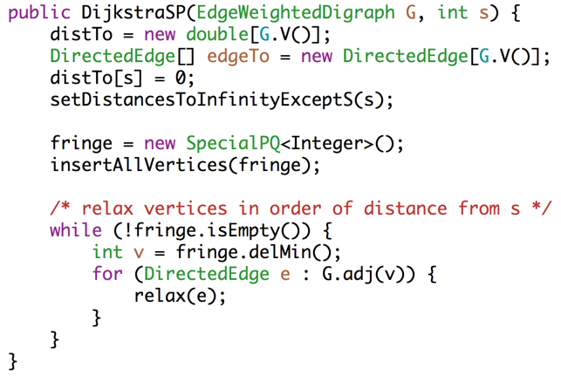
Dijkstra’s Implementation (Pseudocode, 1/2)
Fringe is ordered by distTo. Must be a specialPQ for reasons on next slide.
Get vertex closest to source that is unvisited.
Relax means: If better, add to SPT and update priorities. See next slide.
For an actual implementation see Algorithm’s textbook example.

Slide 24
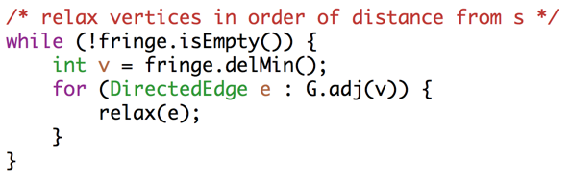
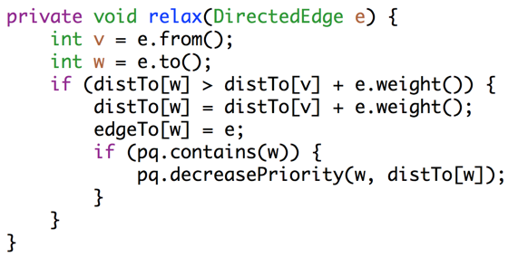
Dijkstra’s Implementation (Pseudocode, 2/2)
Important invariant, fringe must be ordered by current best known distance from source.
Relax means: If better, add to SPT and update priorities.
If edge is better, then:
add to shortest paths tree
if still active (green)
update priority (not a standard PQ operation, requires a special PQ)
For an actual implementation see Algorithm’s textbook example.

Slide 25
Dijkstra’s Algorithm Runtime
Priority Queue operation count, assuming binary heap based PQ:
Insertion: V, each costing O(log V) time.
Delete-min: V, each costing O(log V) time.
decreasePriority: E, each costing O(log V) time.
Operation not discussed in lecture, but it was in lab 10.
Overall runtime: O(V*log(V) + V*log(V) + E*logV).
Assuming E > V, this is just O(E log V) for a connected graph.
 | # Operations | Cost per operation | Total cost
PQ insertion | V | O(log V) | O(V log V)
PQ delete-min | V | O(log V) | O(V log V)
PQ decrease priority | E | O(log V) | O(E log V)

Slide 26
Graph Problems
Problem | Problem Description | Solution | Efficiency
paths | Find a path from s to every reachable vertex. | DepthFirstPaths.java Demo, Iterative Demo | Θ(V+E) time Θ(V) space
topological sort | Find an ordering of vertices consistent with directed edges. | DepthFirstOrder.java Demo | Θ(V+E) time Θ(V) space
shortest paths | Find the shortest path from s to every reachable vertex. | BreadthFirstPaths.java Demo | Θ(V+E) time Θ(V) space
shortest weighted paths | Find the shortest path, considering weights, from st to every reachable vertex. | DijkstrasSP.java Demo | Θ(E log V) time Θ(V) space

Slide 27
Single Target Dijkstra’s
Is this a good algorithm for a navigation application?
Will it find the shortest path?
Will it be efficient?

Slide 28
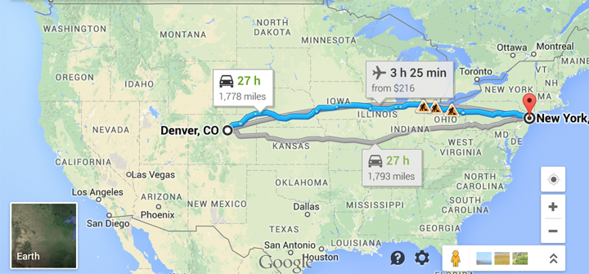
The Problem with Dijkstra’s
Dijkstra’s will explore every place within nearly two thousand miles of Denver before it locates NYC.

Slide 29
A* (CS188 Preview)

Slide 30
The Problem with Dijkstra’s
We have only a single target in mind, so we need a different algorithm. How can we do better?

Slide 31
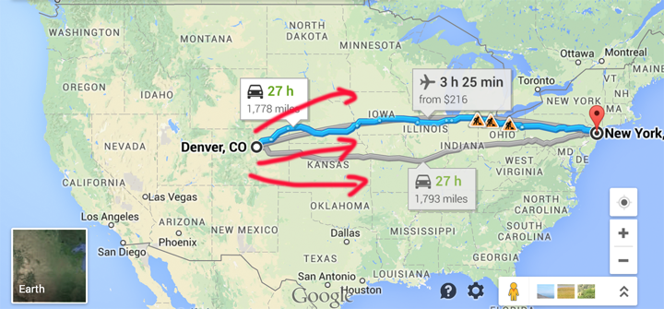
How can we do Better?
Explore eastwards first?

Slide 32
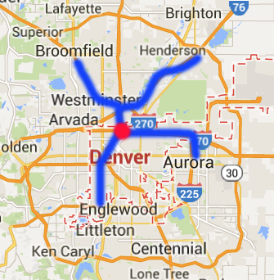
Introducing A*
Simple idea:
Visit vertices in order of d(Denver, v) + h(v), where h(v) is an estimate of the distance from v to NYC.
In other words, look at some location v if:
Compared to Dijkstra’s which only considers d(source, v).
We know already know the fastest way to reach v.
AND we suspect that v is also the fastest way to NYC taking into account the time to get to v.
Example: Henderson is farther than Englewood, but probably overall better for getting to NYC.

Slide 33
A* Demo, with s = 0, goal = 6.
A* Demo Link
Insert all vertices into fringe PQ, storing vertices in order of d(source, v) + h(v).
Repeat: Remove best vertex v from PQ, and relax all edges pointing from v.
3
∞
∞
11
1
1
2
∞
#
0
1
2
3
4
5
6
h(v)
1
3
15
2
5
∞
0
3
2
∞
0
6
5
4
5
s
0
1
∞
1
4
1
Heuristic h(v) estimates that distance from 2 to 6 is 15.
∞
2
15
5

Slide 34
A* and HW4
We did A* in HW4. Example, trying to get from “stories” to “shore”.
Priority queue contained nodes in order of movesMadeSoFar + estimatedDistance.
Graph was stored implicitly in the neighbors() method.
In HW4, all distances were 1.
Example: We look at “store” if:
stones
We know already know the fastest way to reach “stores”.
AND we suspect that “store” is also the fastest way to “shore” taking into account the time to get to “stores”.
store
stories
stores
scores
stored
We used the “Levenstein distance” as our estimate.

Slide 35
Introducing A*
How do we get our estimate?
Estimate is an arbitrary heuristic h(v).
heuristic: “using experience to learn and improve”
Doesn’t have to be perfect!
For the map to the right, what could we use?

Slide 36
Introducing A*
How do we get our estimate?
Estimate is an arbitrary heuristic h(v).
heuristic: “using experience to learn and improve”
Doesn’t have to be perfect!
For the map to the right, what could we use?
As-the-crow-flies distance to NYC.
/** h(v) DOES NOT CHANGE as algorithm runs. */
public method h(v) {
return computeLineDistance(v.latLong, NYC.latLong);
}

Slide 37
Impact of Heuristic Quality
Suppose we throw up our hands and say we don’t know anything, and just set h(v) = 0 miles. What happens?
What if we just set h(v) = 10000 miles?
A* Algorithm:
Visit vertices in order of d(Denver, v) + h(v), where h(v) is an estimate of the distance from v to NYC.

Slide 38
Impact of Heuristic Quality
Suppose we throw up our hands and say we don’t know anything, and just set h(v) = 0 miles. What happens?
We just end up with Dijkstra’s algorithm.
What if we just set h(v) = 10000 miles?
We just end up with Dijkstra’s algorithm.
A* Algorithm:
Visit vertices in order of d(Denver, v) + h(v), where h(v) is an estimate of the distance from v to NYC.

Slide 39
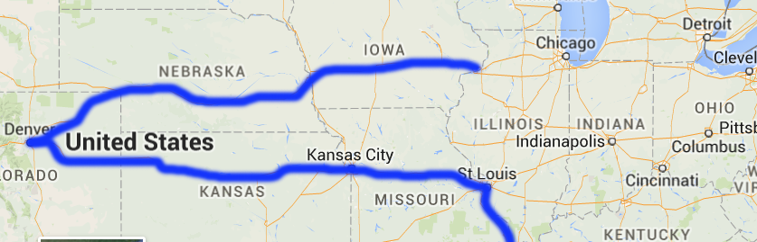
Impact of Heuristic Quality
Suppose you use your impressive geography knowledge and decide that the midwestern states of Illinois and Indiana are in the middle of nowhere: h(Indianapolis)=h(Chicago)=...=100000.
Is our algorithm still correct or does it just run slower?

Slide 40
Surprising Fact (that we won’t prove)
Our middle-of-nowhere was over-estimated the distance from Chicago, since Chicago is less than 100,000 miles from NYC.
We call a heuristic that overestimates to be inadmissible.
A* yields the shortest path if the heuristic is admissible.
In other words, if h(v) never overestimates the distance to NYC, you’ll always get the right answer. If h(v) overestimates, there is no guarantee.
Note: Admissibility is not a necessary condition, consider h(v) = 10000 for all nodes.
Admissible
Heuristics that Yield Correct NYC Route

Slide 41

A* vs. Dijkstra’s Algorithm
http://qiao.github.io/PathFinding.js/visual/
Note, if edge weights are all equal (as here), Dijkstra’s algorithm is just breadth first search.
This is a good tool for understanding distinction between order in which nodes are visited by the algorithm vs. the order in which they appear on the shortest path.
Unless you’re really lucky, vastly more nodes are visited than exist on the shortest path.

Slide 42
Summary: Shortest Paths Problems
Single Source, Multiple Targets:
Can represent shortest path from start to every vertex as a shortest paths tree with V-1 edges.
Can find the SPT using Dijkstra’s algorithm.
Single Source, Single Target:
Dijkstra’s is inefficient (searches useless parts of the graph).
Can represent shortest path as path (with up to V-1 vertices, but probably far fewer).
A* is potentially much faster than Dijkstra’s.
Admissible (underestimating) heuristic guarantees correct solution.

Slide 43
Graph Problems
Problem | Problem Description | Solution | Efficiency
paths | Find a path from s to every reachable vertex. | DepthFirstPaths.java Demo, Iterative Demo | Θ(V+E) time Θ(V) space
topological sort | Find an ordering of vertices consistent with directed edges. | DepthFirstOrder.java Demo | Θ(V+E) time Θ(V) space
shortest paths | Find the shortest path from s to every reachable vertex. | BreadthFirstPaths.java Demo | Θ(V+E) time Θ(V) space
shortest weighted paths | Find the shortest path, considering weights, from s to every reachable vertex. | DijkstrasSP.java Demo | Θ(E log V) time Θ(V) space
shortest weighted path | Find the shortest path, consider weights, from s to some target vertex | A*: Same as Dijkstra’s but with h(v) added to priority of each vertex. Demo | Time depends on heuristic. Θ(V) space

Slide 44
A* Tree Search vs. A* Graph Search
Admissibility vs. Consistency
(Extra: See CS188 for more)

Slide 45
A* Tree Search vs. A* Graph Search
The version of A* we discussed in lecture is called “A* Tree Search” in CS188.
We can optimize A* by “marking” any vertex that has been visited (i.e. dequeued from the PQ), and never enqueuing such vertices again.
Many of you tried this on HW4 by creating a HashSet<WorldState>.
This optimized version of A* is called “A* Graph Search”.
Very important that the vertices are marked only when dequeued, not when they are enqueued. See CS188 for more!
Result is only correct if our heuristic has an additional property called “consistency”.

Slide 46
Heuristic Admissibility and Consistency
Our middle-of-nowhere heuristic actually had two ugly features:
h(Chicago) was an overestimate since Chicago is less than 100,000 miles from NYC.
h(Chicago) and h(St Louis) were inconsistent because h(Chicago) > h(St Louis) + d(Chicago, St Louis).
In other words, we asserted that it takes longer to drive from Chicago to NYC than it does to drive Chicago->St Louis->NYC.
We call a heuristic that disobeys #1 inadmissible, meaning it overestimates, and one that disobeys #2 we call inconsistent.

Slide 47
A* Tree Search vs. A* Graph Search
All consistent heuristics are admissible.
‘Admissible’ means that the heuristic never overestimates.
Admissibility and consistency are sufficient conditions for certain variants of A*.
If heuristic is admissible, A* tree search yields the shortest path.
If heuristic is consistent, A* graph search yields the shortest path.
These conditions are sufficient, but not necessary.
Consistent
Admissible
Heuristics that Yield Correct NYC Route
Notes:
Example of correct but not admissible: h(v) = huge constant.
Example of admissible but not consistent: h(Seattle) = crow distance + 1 mile [coming up with a more general one is quite tricky]

Slide 48
Iterative DFS (Extra)

Slide 49
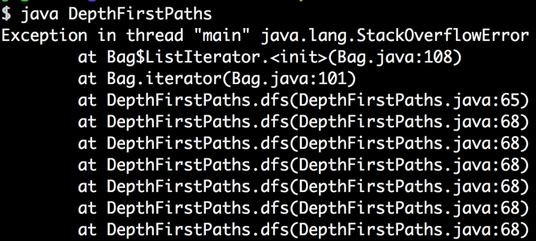
Call Stack for Recursive DFS
Given a graph with a long path:
0
1
2
3
4
5
...
1000000
Call stack is huge:
dfs(0):
dfs(1):
dfs(2):
dfs(3):
dfs(4):
...
Notes:
http://images.devshed.com/ds/stories/Solving%20Problems%20with%20Recursion/2.jpg
https://cdn3.iconfinder.com/data/icons/3d-printing-icon-set/512/Flood_fill.png

Slide 50
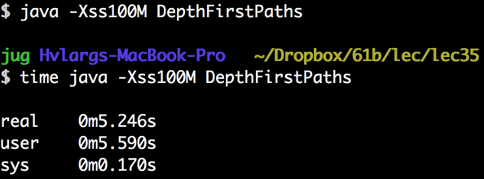
Setting Stack Size
Given a graph with a long path:
0
1
2
3
4
5
...
1000000
One approach, use Xss command line argument to set the stack size.
Will keep from crashing, but Java is slow with deep recursion.

Slide 51
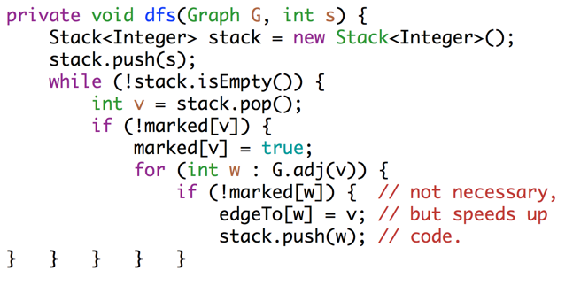
Iterative DFS Implementation
Simplest implementation is similar to BFS:
For the fringe: Use a Stack instead of a Queue.
Do not mark vertex when added to the fringe (subtle but important!)
Instead mark when a vertex is removed from the fringe.
See A-level guide problems.
Demo on Wednesday!

Slide 52
Iterative DFS
Iterative DFS Demo.
Differences from regular DFS:
Won’t crash for very deep recursion.
Probably faster for most graphs.
More awkward to implement.
Visits neighbors in opposite order of adjacency list (instead of same order). This is not particularly important.
Uses Θ(E + V) worst case memory instead of Θ(V) worst case memory. Why? Because vertices can appear on fringe multiple times.
Memory efficient version of iterative DFS is surprisingly tricky. See Bin Jiang's implementation for an example.

Slide 53
Graph Problems
Problem | Problem Description | Solution | Efficiency
s-t paths | Find a path from s to every reachable vertex. | DepthFirstPaths.java Demo, Iterative Demo | Θ(V+E) time Θ(V) space
topological sort | Find an ordering of vertices consistent with directed edges. | DepthFirstOrder.java Demo | Θ(V+E) time Θ(V) space
shortest s-t paths | Find the shortest path from s to evey reachable vertex. | BreadthFirstPaths.java Demo | Θ(V+E) time Θ(V) space
Punchline:
DFS and BFS both traverse entire graphs, just in a different order (like preorder, inorder, postorder, and level order for trees).
Solving graph problems is often a question of identifying the right traversal. Many traversals may work.
Example: DFS for topological sort. BFS for shortest paths.
Example: DFS or BFS equally good for checking existence of path.

